Slide 1
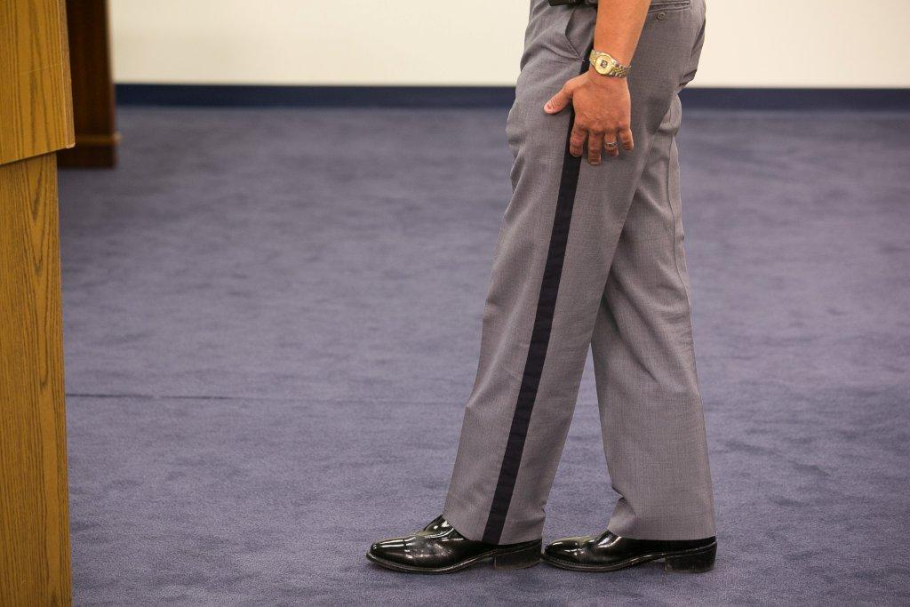



Session 10-A
Dry Lab

Slide 2

Learning Objectives
  Properly administer SFSTs
  Properly observe and record subject’s performance utilizing standard note-taking guide
  Properly interpret subject’s performance
  Properly use and maintain SFST Log

Slide 3
Procedures
Same teams as dry run
Each subject will be viewed performing all three tasks
Only one opportunity to view each subject
Record number of clues observed in appropriate boxes on video recording worksheet

Slide 4
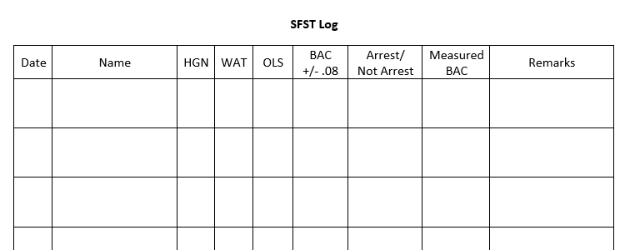
SFST Log

Slide 5
Questions?

